Slide 1
Analyzing Software Measurement Data: Statistical Analysis and Plotting
SE-843: Software Metrics

Slide 2
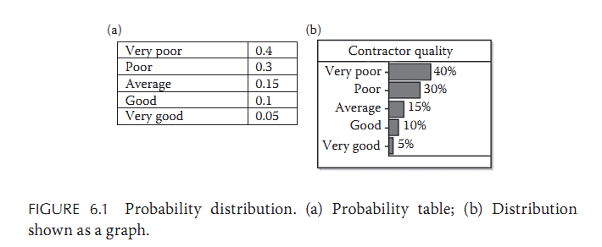
Probability Distributions
Consider the experiment of selecting a contractor to develop a software system. We are interested in the quality of the contractor and therefore consider the set of possible outcomes to be

Slide 3
Probability Distributions
A probability distribution for an experiment is the assignment of probability values to each of the possible outcomes.
On the basis of our previous experience with contractors, or purely based on subjective judgment, we might assign the probabilities to these outcomes as shown in the table of Figure 6.1a.

Slide 4
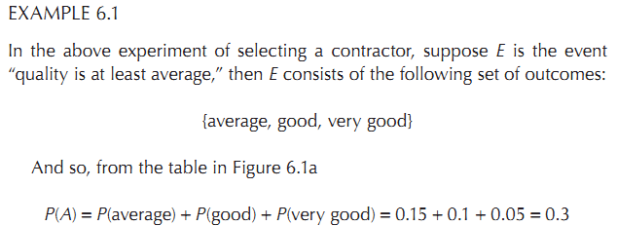
Probability Distributions

Slide 5
Probability Distributions (Discrete)
The notation is a legacy from when discussions revolved primarily around experiments that simply had two outcomes yes and no (or equivalently true and false).
So if we say P(Gui lty) = 0.9, then this genuinely has two meanings. On the one hand, this means the probability of the event “guilty = yes” is 0.9. On the other hand, since it tells us that the probability of the event “guilty = yes” is 0.9, it follows that we also know the whole probability distribution, since P(yes) = 0.9 and P(no) = 0.1.

Slide 6
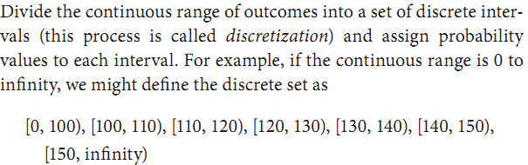
Probability Distributions (continuous)
For experiments with a continuous set of outcomes, such as measuring the height of a person in centimeters, it is meaningless to assign probability values to each possible outcome. Instead, we do one of the following

Slide 7
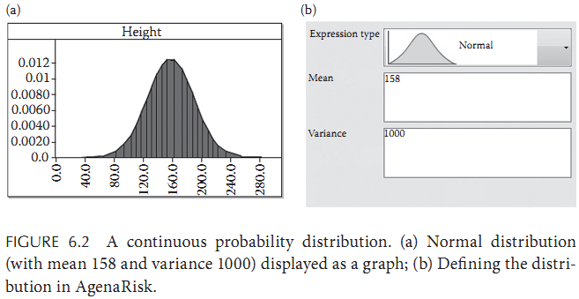
Probability Distributions (normal distribution)

Slide 8
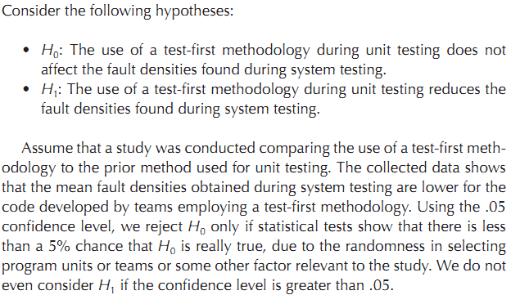
Hypothesis Testing Approaches

Slide 9
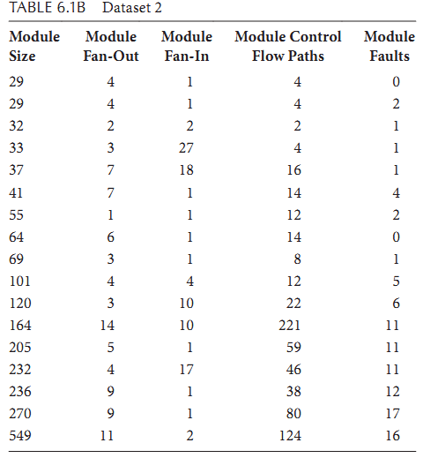
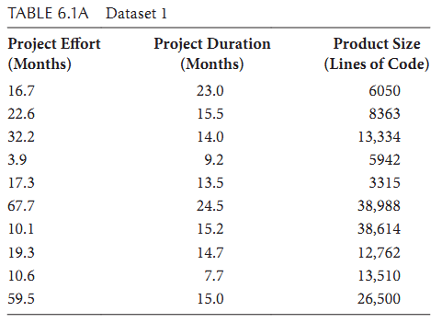
Distribution of Software Measurements

Slide 10
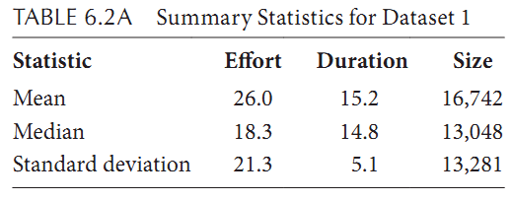
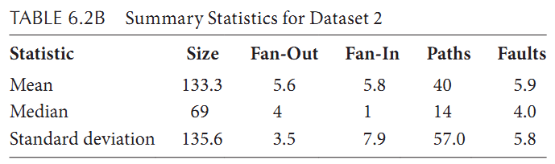
Statistical Representation of Software Measurements

Slide 11
Exploring Software data Relationship
Often, an investigation is designed to determine the relationship among data points describing one variable or across multiple variables.
For example, you may be interested in knowing the normal ranges of productivity or quality on your projects, so that you have a baseline to compare for the future.
A case study may be more appropriate for this objective, but you may want to answer this question as part of a larger experiment.
Several techniques can help to answer questions about a relationship: box plots, bar charts, control charts, scatter plots (or scatter diagrams), and correlation analysis.

Slide 12
Exploring Software data Relationship
A box plot can depict a summary of the range and distribution of a set of data for one variable. It shows where most of the data are clustered and the location of outlier data.
A bar chart provides an alternative way to display a single variable. Bar charts are especially useful when you are comparing the data from a small number of identified entities.
A control chart shows the trends of a variable over time, and can help you to spot occurrences of abnormal data values.
While box plots, bar charts, and control charts show information about one variable, a scatter plot depicts the relationship between two variables.

Slide 13
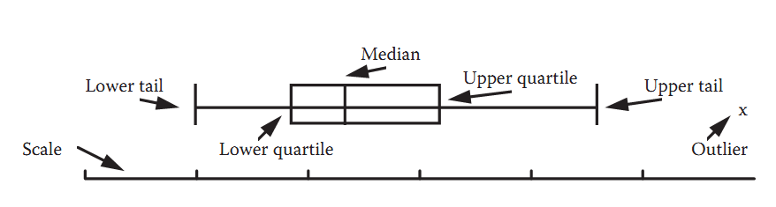
Analysis Techniques: Box Plots
The median is the middle-ranked item in the dataset. That is, the median is the value m for which half the values in the dataset are larger than m and half are smaller than m. The upper quartile u is the median of the values that are more than m, and the lower quartile l is the median of the values that are less than m. Thus, l, m, and u split the dataset into 4 parts.

Slide 14
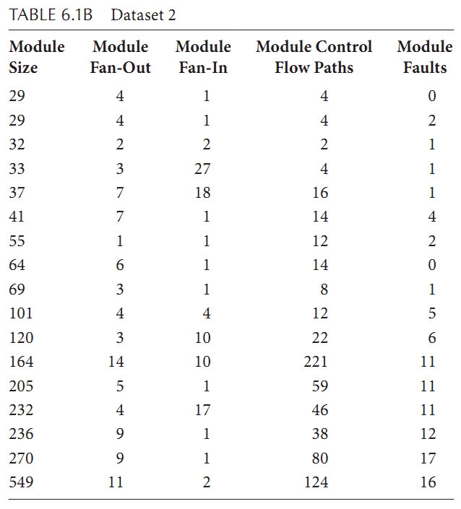
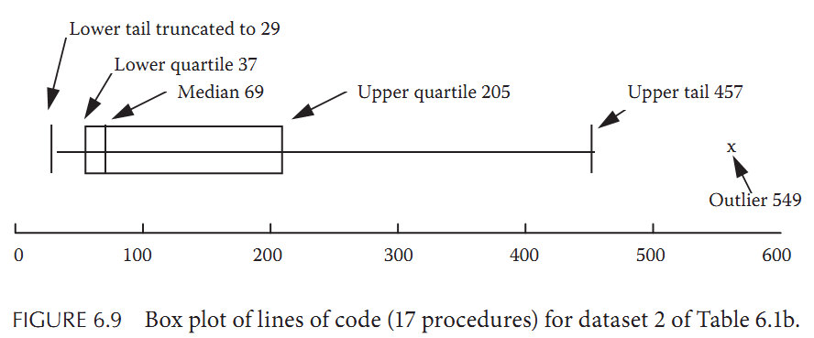
Analysis Techniques: Box Plots

Slide 15
Analysis Techniques: Box Plots
We define the box length, d, to be the distance from the upper quartile to the lower; thus, d = u − l.
Next, we define the tails of the distribution. These points represent the theoretical bounds between which we are likely to find all the data points if the distribution is normal. If the data is on an interval, ratio, or absolute scale, the theoretical upper tail value is the point u + 1.5d, and the lower tail value is l − 1.5d.
Values outside the upper and lower tails are called outliers; they are shown explicitly on the box plot, and they represent data points that are unusual in some way.

Slide 16
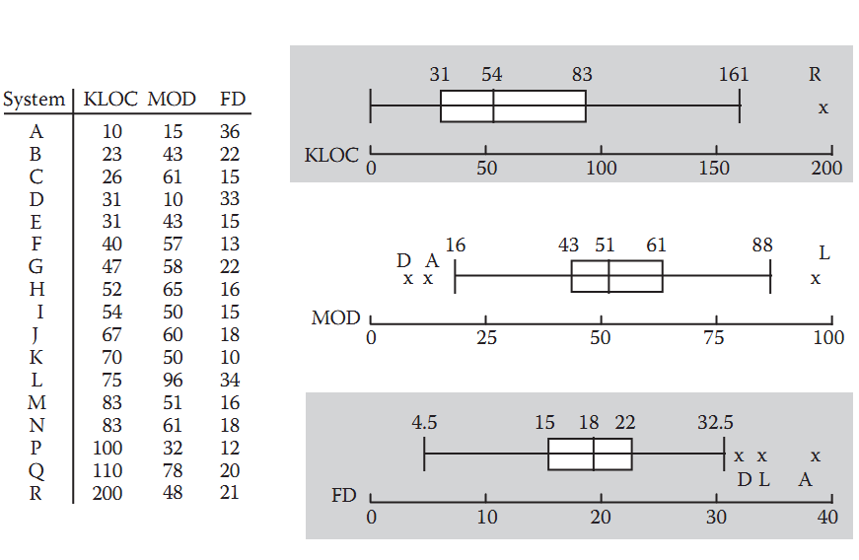
Analysis Techniques: Box Plots

Slide 17
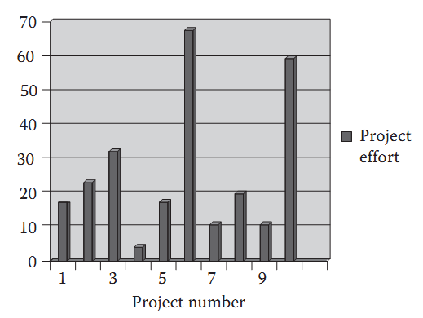
Analysis Techniques: Bar Charts
Unlike box plots, bar charts allow us to readily identify the entity associated with each measured value.

Slide 18
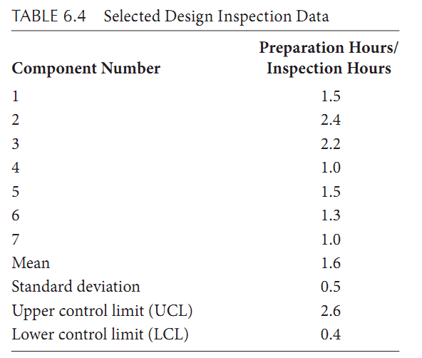
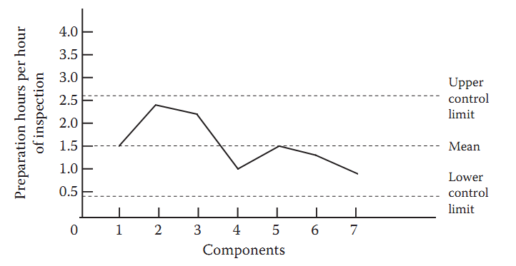
Analysis Techniques: Control Charts

Slide 19
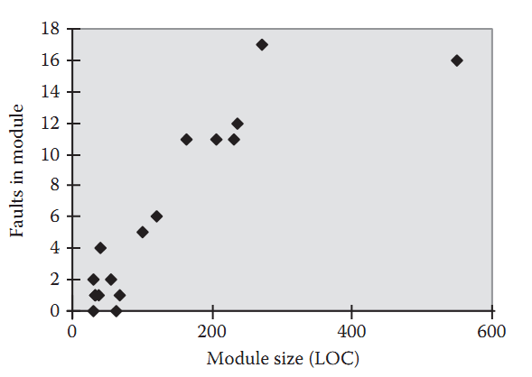
Analysis Techniques: Scatter Plot

